Slide 1

DATA & BUSINESS ANALYST
E – COMMERCE ANALYSIS USING POWERBI
HARIHARASUDHAN S
Portfolio - https://sites.google.com/view/hariharasudhan-s/home
Mail - harish2507.hs@gmail.com
Contact - 86678 69920

Slide 2
Problem Statement
This e-commerce product analysis project aims to provide valuable insights into the e-commerce landscape, benefiting both businesses and consumers by informing strategic decisions and optimizations.
identifying popular product categories and brands.
Analyzing pricing trends and discount strategies.
Understanding seller behavior and performance.
Investigating customer preferences and product satisfaction.
Exploring correlations between various attributes such as price,rating, and brand.
Extract valuable insights from textual data using text analysistechniques, uncovering hidden trends and patterns in productdescriptions and details (Optional).

Slide 3
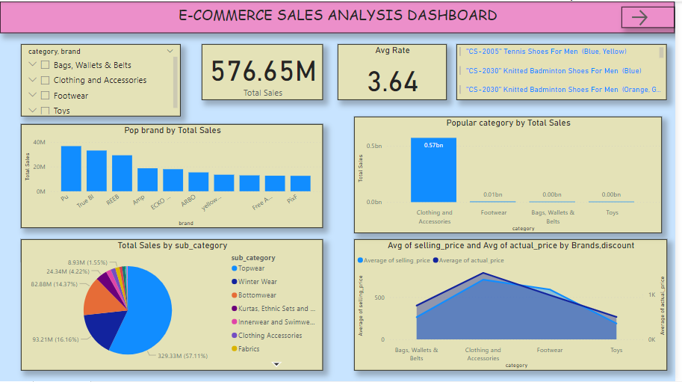
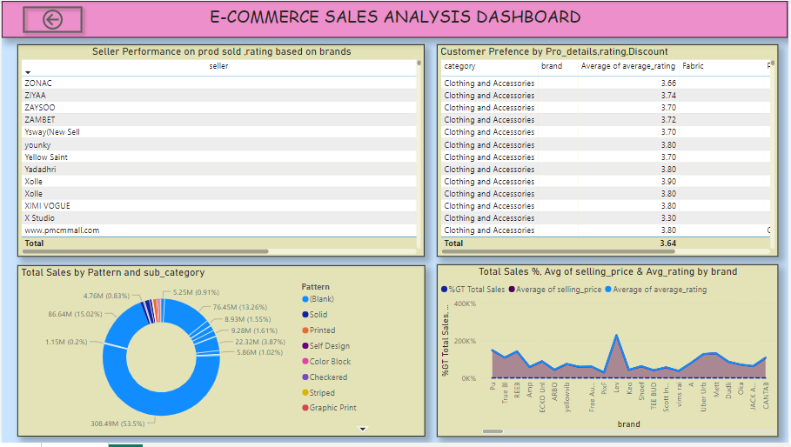
Analysis is Made on PowerBi Tool

Slide 4
DATA CLEANING
The Given data set is in JSON format . So, we get data through JSON format.
We load and Transform the JSON through power query.
We might do Data cleaning and Data processing in power query.
In power query we used first row as header, remove the duplicate and rename the empty field as null.
we also extract the Product details before they are in list format ,we transform and extracted using split by delimiter
we analyze and created new measure for Total Sales
we also analyze and took only the right columns that need for futher requirements.

Slide 5
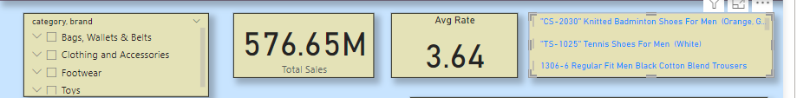
EXPLOTARY DATA ANALYSIS & CHART
Listed the Fashion Products by Brands and Category in Slicer so that Customer as well as seller can easily filter about their needs. In that Slicer card is used.
We set the Card for Total Sales and Average rating for products.
Multi row card is used to show the Title of the products. These are three basic visuals that can easily filter & analyze the products by both Customers & Sellers.

Slide 6
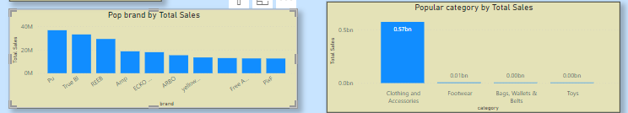
* We find out popular brands and categories through the Total sales of the products.
In X axis we placed Brand and category also filter only Top 10 based Total sales that are
placed in Y axis for this we used (Stacked Column Chart).
* We also find out the over sales distribution of products through the sub-categories. We used pie chart for this(Legend - Sub categories, values - Total Sales)

Slide 7
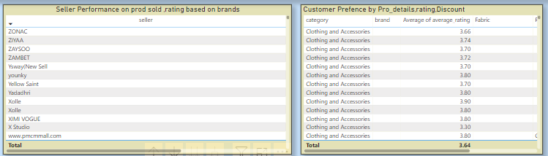
we also find out price distribution and discount strategies based on Avg selling,actual price by category and discount. For this we used area chart (X axis - category,discount ,y axis - Avg sell price , secondary Y axis - Avg actual price)
seller performance based on product sold,rating by brand wise for this we used table chart. list of items we used for table charts are ( columns - seller,count of pid, avg rating,brand).
Customer preference based on product details,rating,discount for this we used table so that user can easy able to view columns like category,brand, avg rating,fabrics etc.

Slide 8
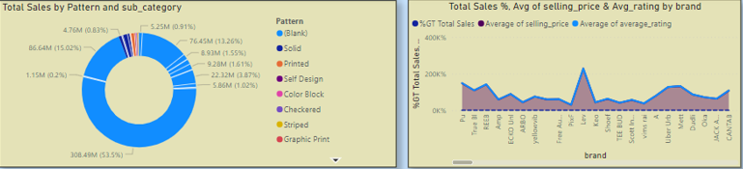
* We have used the Donut chart to show the overall percentage of total sales of products by product details like Pattern , fabrics and their sub - category.
We have used the Line chart to visualize the price details and rating . For this requirements , we used the Total sales %, Avg selling price, Avg rating by Brand wise.
THANKS

